Slide 1
FAKE NEWS DETECTION USING GENETIC ALGORITHM BASED FEATURE SELECTION AND EXPLAINABLE AI
Sai Prasanna Kumar Kumaru, MS AI

Slide 2
CONTENT
Introduction
Motivation & Literature Review
Exploratory Data Analysis
Methodology
Architecture
Results
Conclusion
Future Work

Slide 3
INTRODUCTION
With rise of social media and digital platforms, fake news has become a significant challenge with widespread of false information
It is important to protect society to stop spreading misinformation
This study proposes use of ML and DL algorithms with feature selection techniques in accurately detecting fake news
careful selection of features to be used in the detection model is crucial
we compare and contrast various algorithms with genetic algorithm based feature selection technique with baseline models
Furthermore, to extract meaningful insights from the model, we use explainable AI(XAI) for evaluating fake news

Slide 4
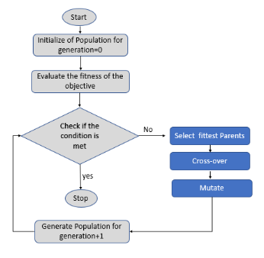
MOTIVATION & LITERATURE REVIEW
With the rise of technology, fake news creators have become increasingly sophisticated in their approach, making it harder to detect these news contents.
Previous methods propose various feature extraction and selection techniques that utilize genetic and evolutionary methods.
ML/DL algorithms reviewed include Logistic, K-NN, Random Forest, XGBoost, BERT, and CNN-LSTM.
Explainable AI techniques such as LIME and SHAP are being used to interpret the results of deep learning models.
Genetic Algorithm Overview
Notes:
Te prior approaches lack an interpretable AI component in the study, which could verify the significance of the model's outputs.

Slide 5
DATASETS
Performed analysis by combining two datasets
WELFake Dataset
Fake and real news dataset from Kaggle
WELFake
dataset of 72,134 news articles with 35,028 real and 37,106 fake news
merged four popular news datasets (i.e. Kaggle, McIntire, Reuters, BuzzFeed Political)
Contains three columns – Title, text content, label
Kaggle Fake and real news dataset
dataset of 44,898 news articles with 21,417 real and 23,481 fake news
Contains 5 columns – Title, text, subject, date, target.

Slide 6
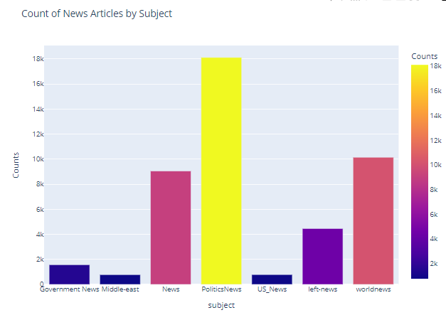
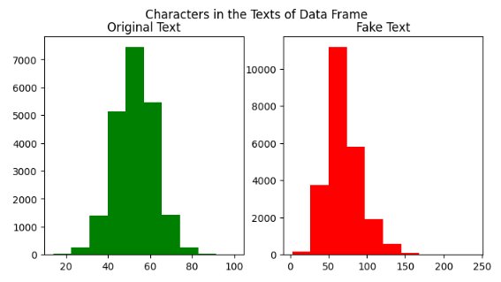
EXPLORATORY DATA ANALYSIS
Avg # of characters in real news (52) < fake news (69)
Most news are related to Politics(40%), and WorldNews (22%)

Slide 7
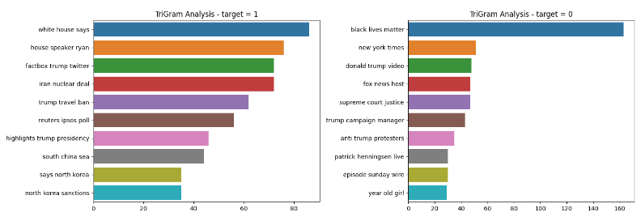
EXPLORATORY DATA ANALYSIS
Notes:
Ref:-
https://www.kaggle.com/code/sohamohajeri/buzzfeed-news-analysis-and-classification
https://www.kaggle.com/code/paramarthasengupta/fake-news-detector-eda-prediction-99#Lets-try-to-identify-the-distribution-of-word-counts-in-the-texts

Slide 8
SYSTEM DESIGN
Data Preprocessing
Text Normalization | Stop words removal | Tokenization | Stemming
Word Embeddings
Word2Vec
Feature Selection
PCA | Genetic Algorithm based
Data Preprocessing
Model Training
Model Training
Logistic
KNN
Random Forest
XGBoost
LSTM + CNN
BERT
Model Evaluation
Performance Analysis
Accuracy | Precision | Recall | F1-Score
SHAP Analysis
Features Importance | Positive or negative Impact | Global and Local interpretability
Post Processing

Slide 9
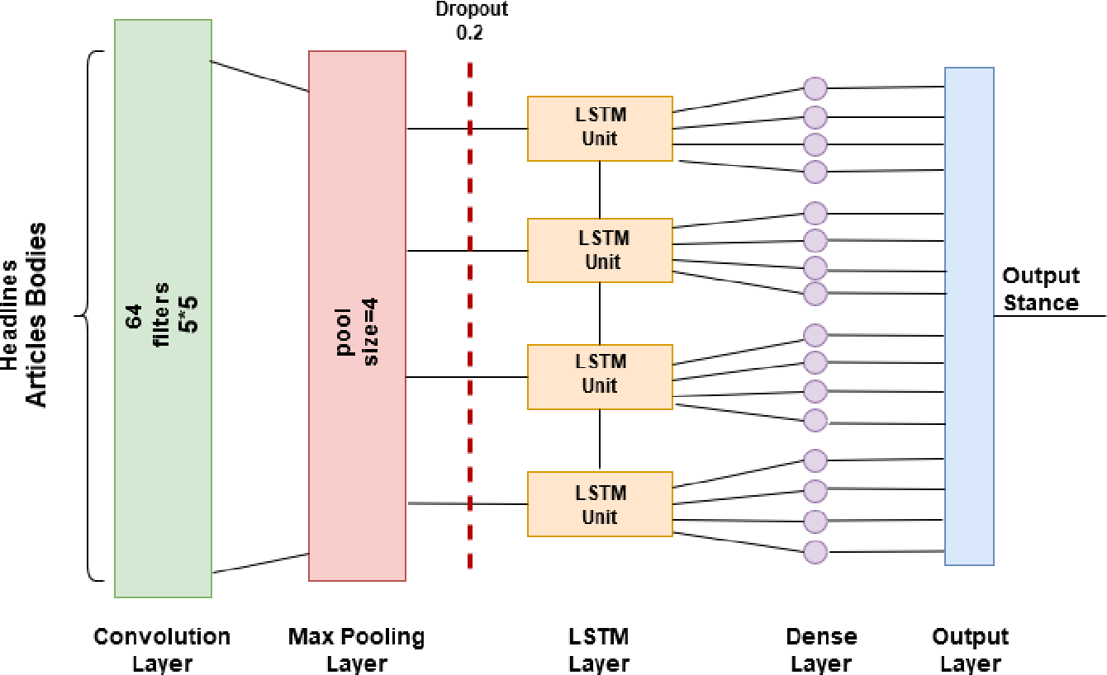
CNN+ LSTM MODEL ARCHITECTURE
Combines Convolutional Neural Network (CNN) and Long Short-Term Memory (LSTM) layers
Used Word2Vec pre-trained word embeddings for input representation
Combines the strengths of CNN and LSTM layers for effective feature extraction and sequence modeling
Notes:
https://www.google.com/url?sa=i&url=https%3A%2F%2Fwww.semanticscholar.org%2Fpaper%2FFake-News-Stance-Detection-Using-Deep-Learning-Umer-Imtiaz%2Fcedc6a965d17ceaba7fcf8cb96c33059dadcc992&psig=AOvVaw2kOAbKDZ1Lxctub61yAKvm&ust=1683321396747000&source=images&cd=vfe&ved=0CA8QjhxqFwoTCMD5q4HL3P4CFQAAAAAdAAAAABAf
Ref - https://www.semanticscholar.org/paper/Bidirectional-LSTM-Based-on-POS-tags-and-CNN-for-Balwant/a2566773e3cfaa6676506ffad86b5d487d947588

Slide 10
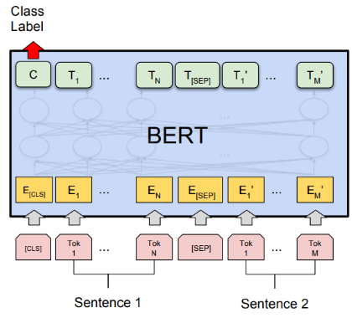
BERT (Bidirectional Encoder Representations from Transformers)
State-of-the-art pre-trained language model that utilizes a deep neural network architecture called Transformers.
Understand the contextual relationships and meanings of words in a sentence by considering the surrounding words
In fake news detection, BERT can be used to analyze the textual content of news articles and identify patterns that distinguish between real and fake news.
By understanding the context and semantics of the text, BERT can capture subtle linguistic cues that indicate the authenticity or deceptive nature of the news
Notes:
BERT is pre-trained on a large corpus of text data, which provides it with a broad understanding of language. However, it needs to be fine-tuned on a specific task, such as fake news detection, using labeled training data to optimize its performance for the target application.
Fine-tuning BERT involves adapting the pre-trained model by adding a classification layer on top of it. This layer is trained on labeled data, where the model learns to classify news articles as either real or fake based on the extracted features from BERT. The fine-tuned BERT model can then be used to classify new, unseen news articles.

Slide 11
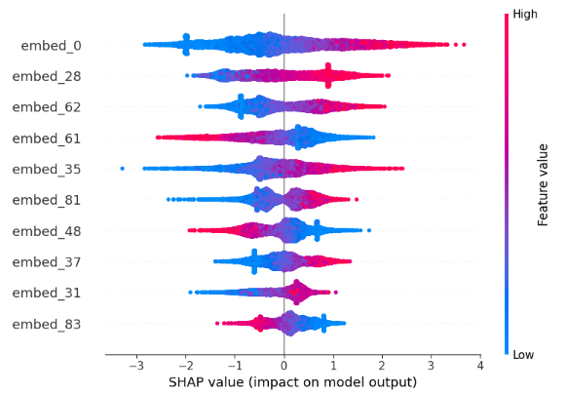
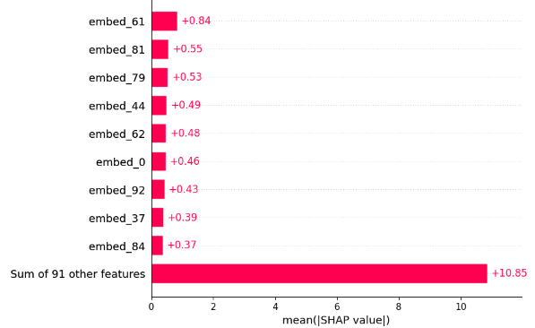
POST PROCESSING – EXPLAINABLE AI (SHAP, LIME)
Explainable AI techniques provide insights into model behavior and improve trust and transparency.
SHAP is powerful technique for interpreting black box models.
It provides feature importance and insights into how features interact with each other to make decisions.
We can visualize the positive or negative impact of features on model predictions
It is useful in explaining the decision-making process of models and providing actionable insights for improvement.
Notes:
A feature is important if permuting its values increases the model error, and SHAP identifies these feature

Slide 12
RESULTS
Baseline Algorithms
Genetic Engineered Feature Selection
Algorithm | Accuracy | Precision | Recall | F1-Score | Accuracy | Precision | Recall | F1-Score
Logistic Regression | 83.8% | 83.5% | 82.7% | 83.1% | 85.5% | 85.6% | 84.1% | 84.8%
KNN | 76.3% | 76.2% | 73.7% | 74.9% | 77.1% | 77.2% | 73.9% | 75.5%
Random Forest | 84.9% | 85.2% | 82.9% | 84.1% | 84.6% | 84.9% | 82.6% | 83.7%
XGBoost | 83.89% | 84.6% | 81.2% | 82.8% | 85.4% | 85.5% | 83.4% | 84.5%
Deep Learning Algorithms
Algorithm | Accuracy | Precision | Recall | F1-Score
CNN-LSTM | 88.4% | 84.5% | 93.0% | 88.6%
BERT | 94.5% | 94.8% | 93.7% | 94.2%

Slide 13
CONCLUSION
Emphasized role of AI in need for detecting and controlling spread of fake news
Proposed approach CNN-LSTM architecture shows promise in improving the detection of fake news, although BERT outperformed all other traditional models.
Adding genetic engineered features helps us in selecting impactful features while training a model.
Improved accuracy and other evaluation metrics by atleast 1-3%
Using explainable AI packages such as SHAP, LIME helps us with interpretability of the models.
Challenges:
Lack of comprehensive datasets that captures different aspects of fake news as model performance is highly dependent on quality and quantity of the data used for training and testing
Computing shap values for large dataset is computationally expensive. So, we need to find a way to explain model outputs for meaningful insights

Slide 14
FUTURE WORK
Need more comprehensive and diverse datasets that can capture different aspects of fake news.
Advanced feature extraction and selection techniques can be explored. Ex:- Using transformer based models like GPT could be effective
Hybrid models that combines different types of models, feature sets and evaluation metrics can be explored
Advanced XAI techniques such as Counterfactual Explanations, Model-Agnostic Meta-Learning(MAML), can be explored to provide more meaningful insights into decision-making process of models.

Slide 15
References
[1] Z. Tian and S. Baskiyar, "Fake News Detection using Machine Learning with Feature Selection," 2021 6th International Conference on Computing, Communication and Security (ICCCS), Las Vegas, NV, USA, 2021, pp. 1-6, doi: 10.1109/ICCCS51487.2021.9776346.
[2] M. Aljabri, D. M. Alomari and M. Aboulnour, "Fake News Detection Using Machine Learning Models," 2022 14th International Conference on Computational Intelligence and Communication Networks (CICN), Al-Khobar, Saudi Arabia, 2022, pp. 473-477, doi: 10.1109/CICN56167.2022.10008340.
[3] M. Umer, Z. Imtiaz, S. Ullah, A. Mehmood, G. S. Choi and B. -W. On, "Fake News Stance Detection Using Deep Learning Architecture (CNN-LSTM)," in IEEE Access, vol. 8, pp. 156695-156706, 2020, doi: 10.1109/ACCESS.2020.3019735.
[4] Julio C. S. Reis, André Correia, Fabrício Murai, Adriano Veloso, and Fabrício Benevenuto. 2019. Explainable Machine Learning for Fake News Detection. In Proceedings of the 10th ACM Conference on Web Science (WebSci '19). Association for Computing Machinery, New York, NY, USA, 17–26. https://doi.org/10.1145/3292522.3326027

Slide 16
THANK YOU

Slide 17
CHALLENGES
Generalizability of model across different domains. Transfer learning could be the solution to address the challenge but it also requires comprehensive dataset that captures different aspects of fake news
Lack of comprehensive datasets that captures different aspects of fake news as model performance is highly dependent on quality and quantity of the data used for training and testing.
Choosing the right set of features for detecting fake news is crucial, as it can significantly impact the performance of the models. Therefore, selecting the appropriate feature extraction and selection techniques is a challenge that needs to be addressed.
Computing shap values for large dataset is computationally expensive. So, we need to find a way to explain model outputs for meaningful insights

